Slide 1

Abroad Squad + Chris
Ciao!
Patrick Zambri, Bradford Harris, Marisa Proscia, Chris Siena, Jacob Levinson

Slide 2

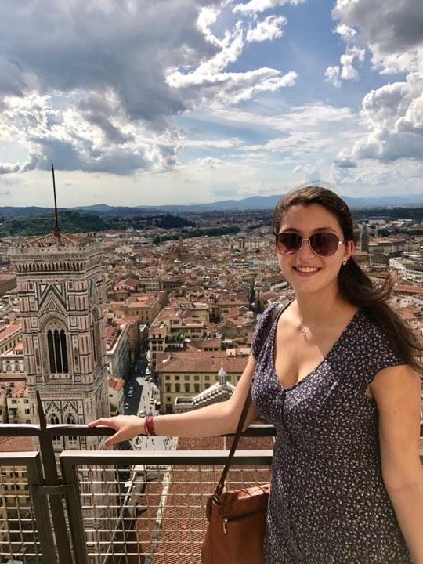
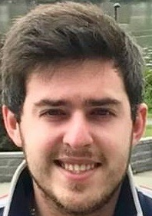
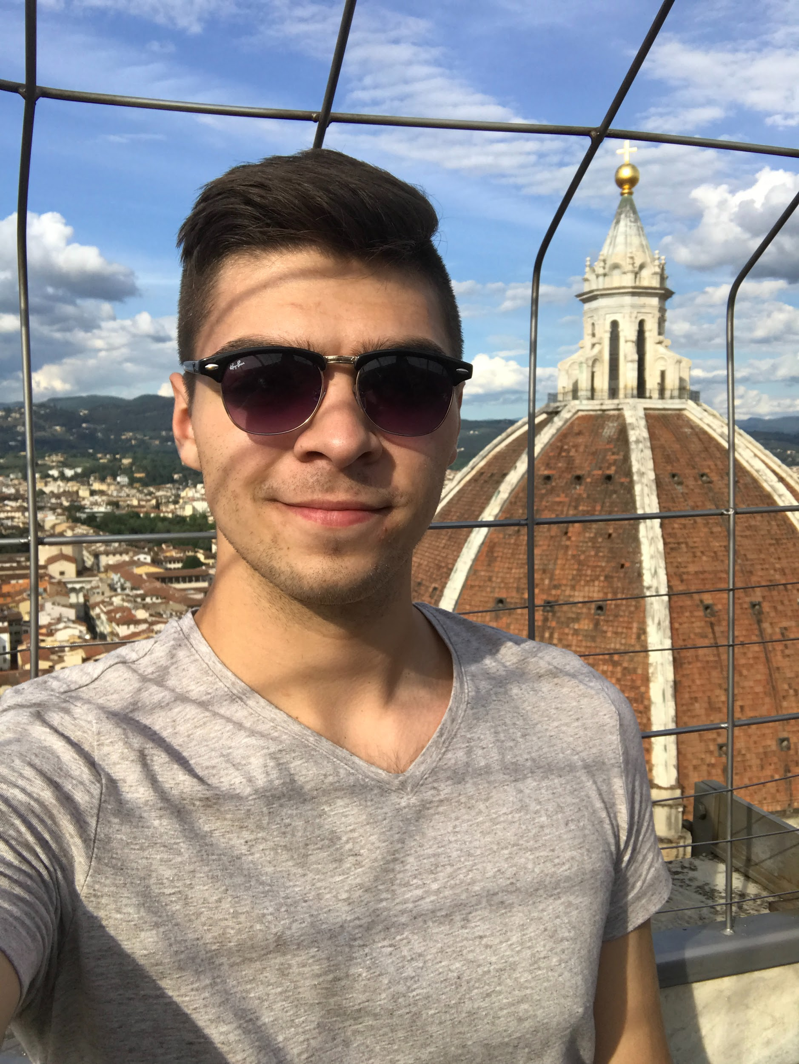
Team Pictures
(Pat)
(Pat)

Slide 3
Schedule
Week | Requirements | Development | Testing | Members
5 | Begin work on basic functionality of website and features Homework 3 due | Finalize website UI mockups. Compare mockups to client specifications. |  | Marisa, Jacob, Chris Brad All
6 | Final Project Plan & UML Diagrams | Ensure team is staying on track with plan while providing realistic expectations to the client and constantly updating Project Plan. Finalize Project Plan based on updates and instructor feedback. Finalize UML Diagrams. Continue work on website functionality and features. |  | Brad Patrick Marisa, Jacob, Chris
7 | Database Design Draft Due | Create database design draft. Implement database design standards to draft. |  | All
8 | Initial Peer Reviews Due | Individually Complete first round Peer Reviews. Revisit database architecture and prepare prototype for production. | Test overall website functionality. | All Chris, Marisa, Jacob
9 | IT Requirements Draft Due | Revisit database architecture and prepare prototype for production. Team meeting to finish draft of IT requirements & network design. |  | Chris, Marisa, Jacob Brad,Patrick
10 | Complete Database Prototype Homework 4 Due | Complete Database Prototype. Ensure work is being completed on time in order to be ready for the demo in week 11. |  | Chris, Marisa, Jacob Brad All
11 | Demo of Prototype prepared | Provide a demo of a functioning prototype website. |  | All

Slide 4
Project Status
 | Schedule | We are adhering to our development schedule, but slow progress due to midterms and other obligations.
 | Technical | Adding New Coaches
 | Technical | Login Page
 | Technical | Bootstrap CSS - Learning how to use it.
 | Technical | PHP Development - Working on bringing functionality to site.
 | Technical | Database - Finalizing design
 | Resource | Learning about the DOD/NIST Security Standards
 | Other | N/A

Slide 5
Project Progress
Accomplishments
We can now add new coaches
We picked a CSS Framework: Bootstrap
Functional Login Page with CSS
Activities Being Worked
Learning about Bootstrap
Continuing Front End Development
Roadblocks
Learning about Bootstrap
Learning about DOD/NIST Security Standards
Midterms & Fall Break

Slide 6
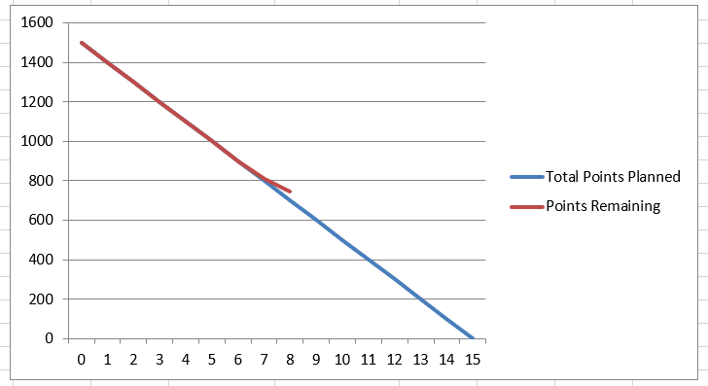
Burndown Chart

Slide 7
Scope of Project
What it is | What it is not
A website and mobile application | A desktop application

Slide 8
Project Risks
Risk | Score | Mitigation
Time .. Nothing new | High | Keep working.

Slide 9
Project issues
Issue | Owner | Action Plan | Checkpoint Date
CSS Framework: Bootstrap- How does one use it? | Marisa, Jacob, Brad, Chris | Research & Ask Questions | 10/25/2017
DOD/NIST Security Standards | Pat | Going to Pablo’s Office Hours | 10/25/2017

Slide 10
Lessons Learned
Lessons Learned | Corrective Action / Recommendation
Gathering Client Requirements is the most important step in the development process | Ensure all clients needs are going to be satisfied by the system design by asking questions before and during the development process.
Always ask for help | It is great to work out a solution on your own, but in some scenarios it is best to reach out to others for assistance, versus spending too much time on something.
Encryption troubles | Learned how to correctly install and configure MCrypt on ubuntu 14
Mobile First! | We picked Bootstrap as our CSS Framework because of its push for a responsive mobile UI.

Slide 11
Communication Matrix
Stakeholder Name | Information Required | Timing / Frequency | Delivery Method | Owner
Client (Professor Rivas) | User Requirements | As Needed | Forum Posts, via email | Entire Team
Team Meeting | Team updates, system updates, complete homework | Meet weekly , communicate almost daily | In-Person Meeting, Group Chat | Entire Team

Slide 12
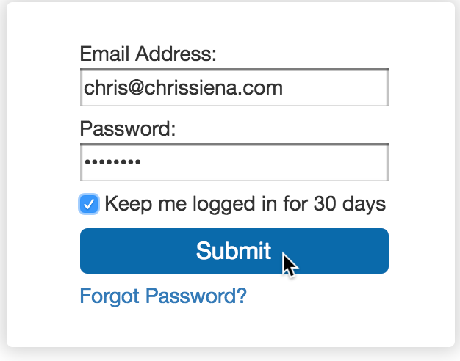
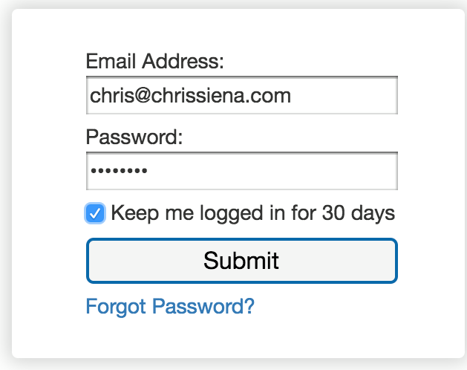
Login

Slide 13
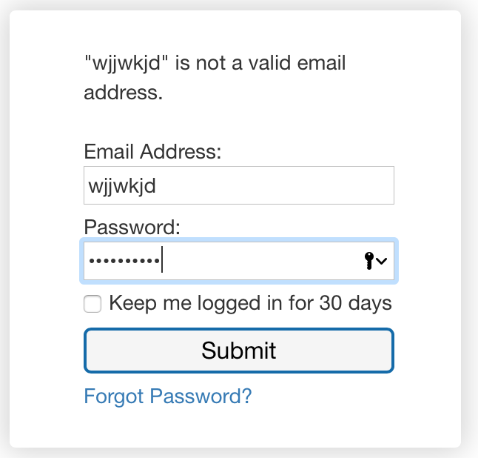
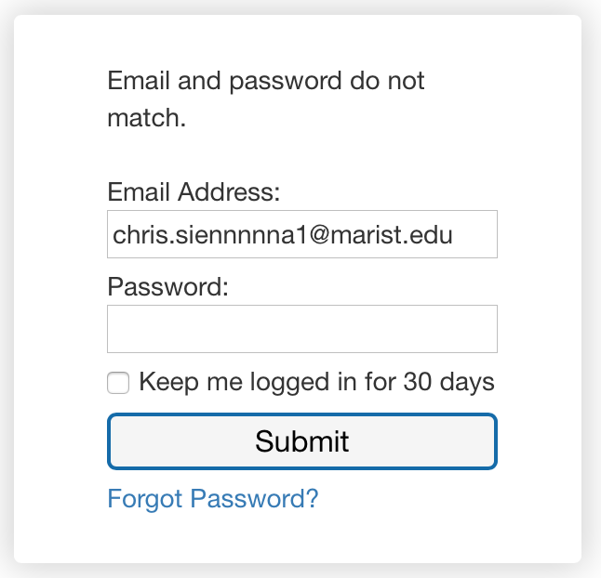
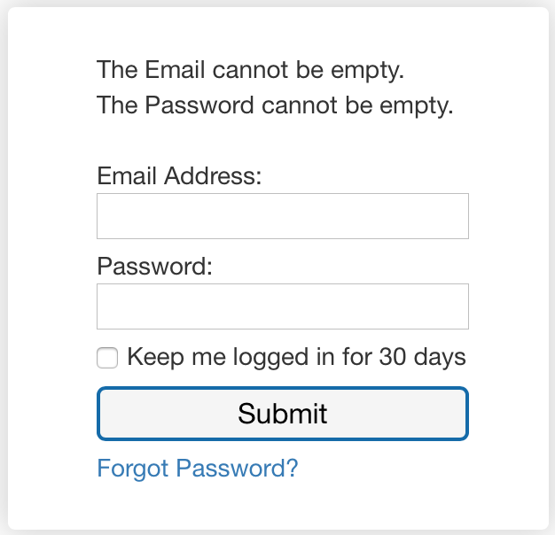
Login

